Slide 1
SmartPlant 3D Grids Task

Slide 2

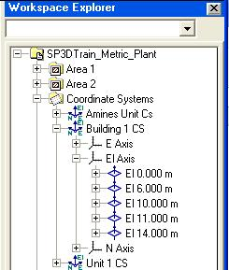
Coordinate Systems
One global coordinate system per model database
One or more Design coordinate systems
Design coordinate system is a persisted object
Graphically indicated by a view zoom independent triad
Appears in the Workspace Explorer
CS Name can be user defined
Creation of a Design coordinate system can be done using the Place Coordinate System command or the Grid Wizard command

Slide 3
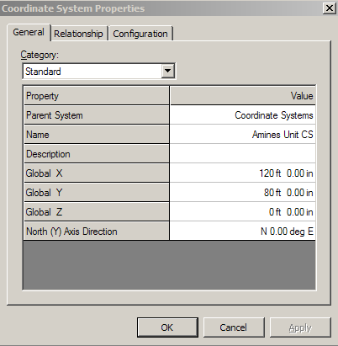
Coordinate Systems
Coordinate System Ribbon Bar and Properties Page
  Setting
  Origin step
  Axis Direction step
  Reference Axis
  Bearing angle ( From Dir xx deg To Dir)
  System
  Name

Slide 4
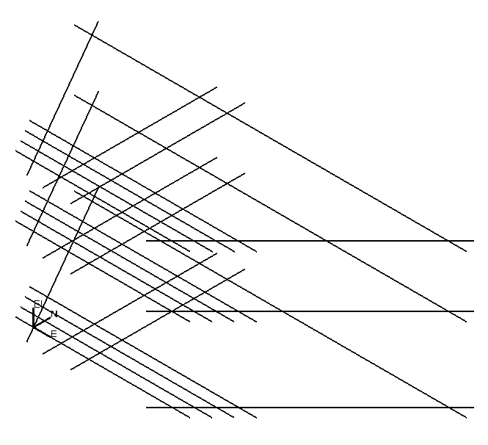
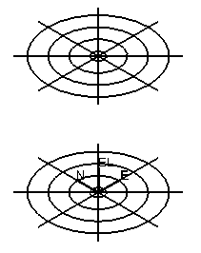
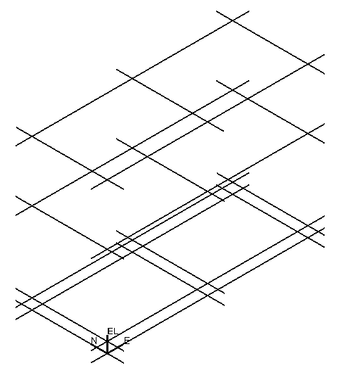
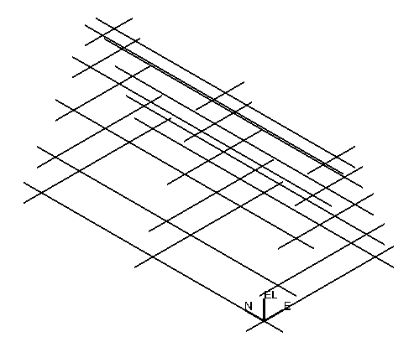
Grid Systems
Most Grid Systems are defined early in the design activity to establish the primary positional references (layout) for the design
Sets of gridlines defined by reference planes
Imposes rectangular/skewed/radial frame
Associative behavior
Rule based Naming Rule

Slide 5
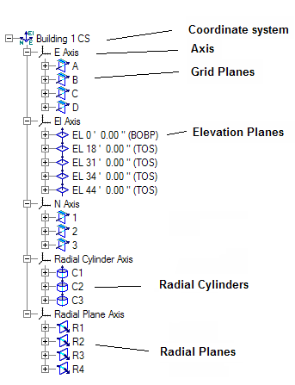
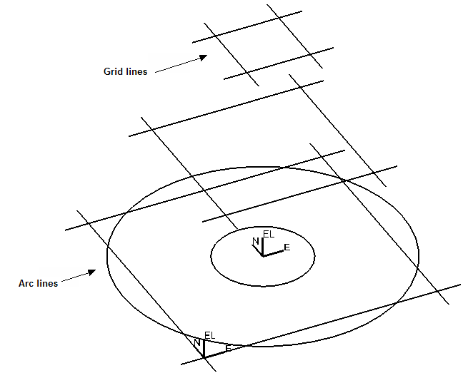
Grid Entities
Coordinate system
Axis
Elevation Planes
Grid Planes
Radial Planes
Radial Cylinders
Gridlines
Grid Arcs

Slide 6
Grid Wizard Command
The intend of this command is to help users in the creation of elevation and reference planes.
Step 1 – Establish a Design coordinate system
Step 2 – Create the Elevation planes
Step 3 – Create the Easting planes
Step 4 – Create the Northing planes
Step 5 – Create the Radial cylinders
Step 6 – Create the Radial planes
Step 7 – Select arbitrary elevation planes from each
reference plane to produce gridlines for the grid system

Slide 7
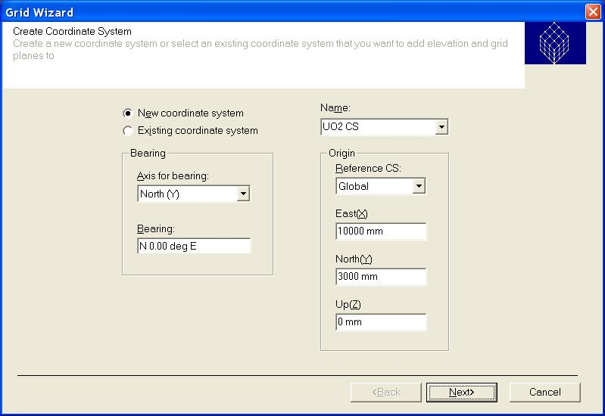
Grid Wizard Command
Grid Wizard Step 1 command
The grid wizard command uses the last inputs.
Create New or Select existing Coordinate System (CS)
Key-in Name
Location of the Coordinate System (X,Y,Z) and Reference
Orientation of the Coordinate System

Slide 8
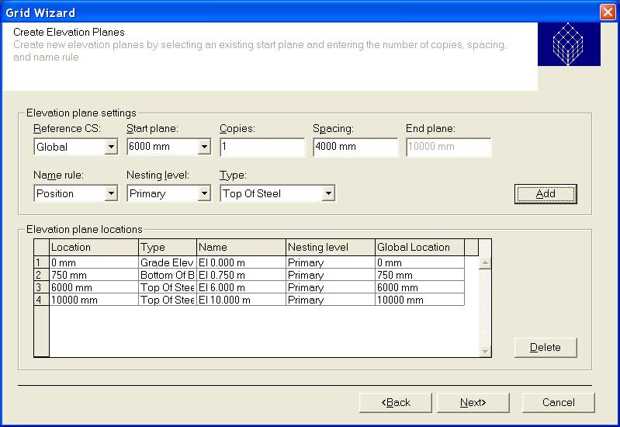
Grid Wizard Command
Reference CS: Reference for locations
Start plane: Defines starting location of the first plane
Copies: Number of copies of El. planes to be created
Spacing: Defines the spacing to be used between El. planes.
End Plane: Shows the location of the last plane
Name Rule: Rule to label the El. planes.
Nesting level: primary, secondary or tertiary
Type: Elevation type
Add: Adds multiple EL. Plane to the table based on the settings.
Example of Naming Rule
By Index ElevPlane1, ElevPlane2
    By Position El 10m, El 20m
Grid Wizard Step 2 command

Slide 9
Grid Reference Plane Types
Grid Wizard Command
User-definable code-list values
Useful for filters, name rules, connection rules
Elevation Plane Types
  Undefined
  Top Of Steel
  Top Of Concrete
  Bottom Of Base plate
  Bottom Of Concrete
  Column Splice Elevation
  Grade Elevation
  Reference Plane Types
    Undefined
    N-S Grid Plane
    E-W Grid Plane
    Expansion Join Plane

Slide 10
Grid Task
Plane Naming Rules
 | Primary | Secondary | Tertiary
Alphanumeric and percent | A | A.5 | A.5.5
Imperial Position | El15’ 0.00”
Index | GPX2 | GPX2.1 | GPX2.1.1
Index and percent | GPY1 | GPY1.5 | GPY1.5.5
Position | El 6000mm
User Defined | xxxx | xxxx | xxxx

Slide 11
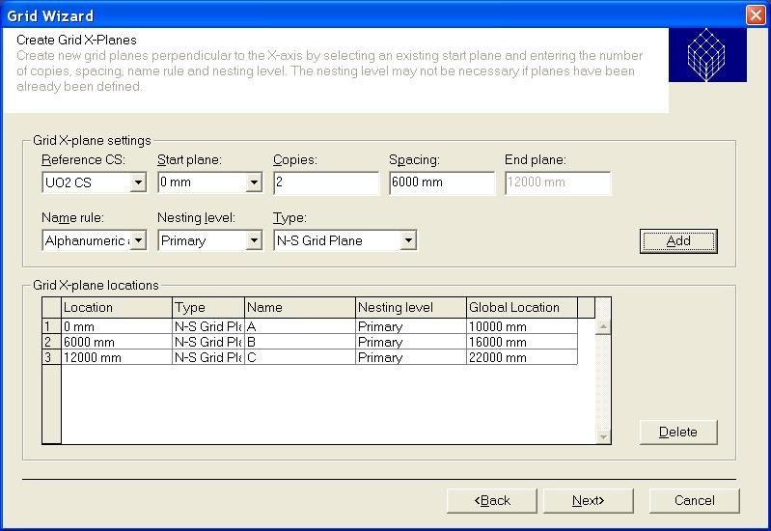
Grid Wizard Command
Grid Wizard Step 3 command
Reference CS: Reference for locations
Start plane: Defines starting location of the first plane.
Copies: Number of copies of X-Planes to be created.
Spacing: Defines the spacing to be used between X-Planes.
End Plane: Shows the location of the last plane.
Name Rule: Rule to label the X-Planes.
Nesting Level: primary, secondary, tertiary.
Type: Grid type
Add: Adds multiple X-plane to the table based on the settings.

Slide 12
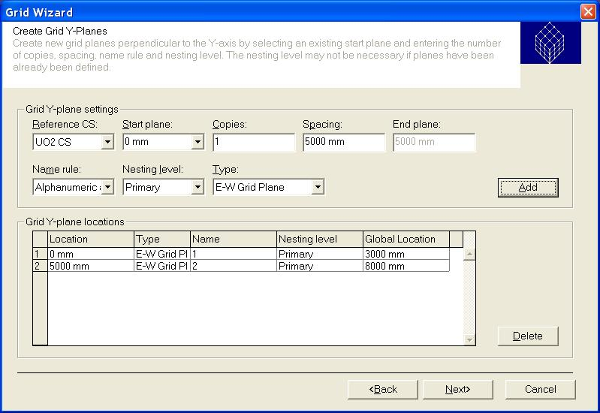
Grid Wizard Command
Grid Wizard Step 4 command
Reference CS: Reference for locations
Start plane: Defines starting location of the first plane.
Copies: Number of copies of Y-Planes to be created.
Spacing: Defines the spacing to be used between Y-Planes.
End Plane: Shows the location of the last plane.
Name Rule: Rule to label the Y-Planes.
Nesting Level: primary, secondary, tertiary.
Type: Grid type
Add: Adds multiple Y-Plane to the table based on the settings.

Slide 13
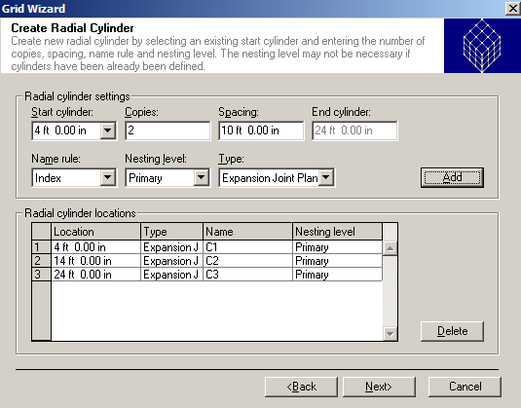
Grid Wizard Command
Grid Wizard Step 5 command
Start plane: Defines starting location of the first Radial Cylinder.
Copies: Number of copies of Radial Cylinder to be created.
Spacing: Defines the spacing to be used between Radial Cylinders.
End Cylinder: Shows the location of the last cylinder.
Name Rule: Rule to label the cylinders.
Nesting Level: primary, secondary, tertiary.
Type: Grid type
Add: Adds multiple Radial Cylinders to the table based on the settings.

Slide 14
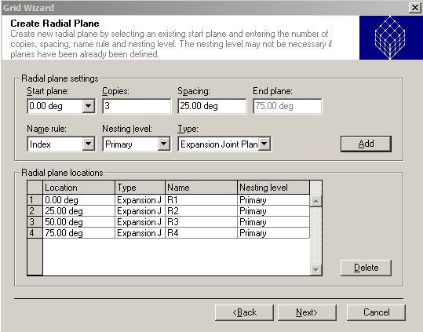
Grid Wizard Command
Grid Wizard Step 6 command
Start plane: Defines starting location of the radial plane.
Copies: Number of copies of Radial Planes to be created.
Spacing: Defines the spacing to be used between Radial Planes.
End Plane: Shows the location of the last plane.
Name Rule: Rule to label the Radial Planes.
Nesting Level: primary, secondary, tertiary.
Type: Grid type
Add: Adds multiple Radial Plane to the table based on the settings.

Slide 15
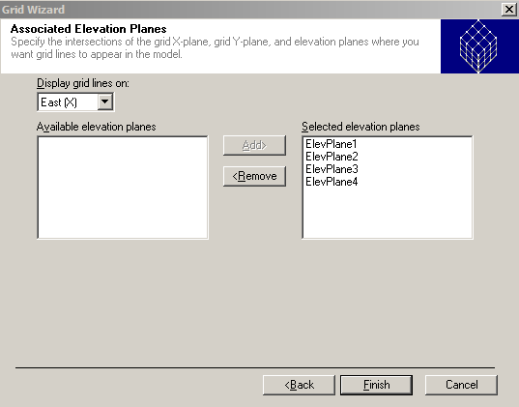
Grid Wizard Command
Grid Wizard Step 7 command
Select arbitrary elevation planes from each grid plane to produce grid lines/arcs for the grid system.
All grid lines/arcs are displayed for each X and Y planes by default.

Slide 16
Lab - 1

Slide 17
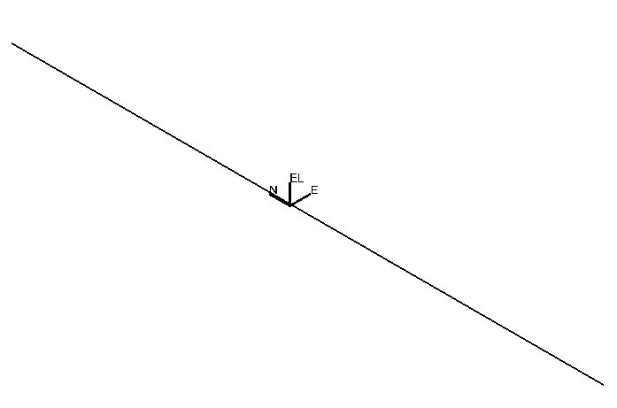
Grid Systems
1meter
The default of an unbounded grid line is 100 meters
Extend grid line by 1 meter distance past last bounding grid planes
100 meter

Slide 18
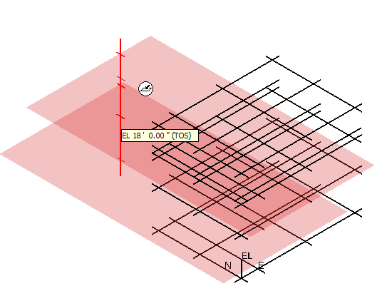
Grid Entities Manipulation
Place/Edit Elevation Plane Command
Control-Shift select Elevation Planes from Rulers (like WSE)
Dynamic display of new Elevation Plane location on ruler
Multi-Select El Planes
Dynamic
Display

Slide 19
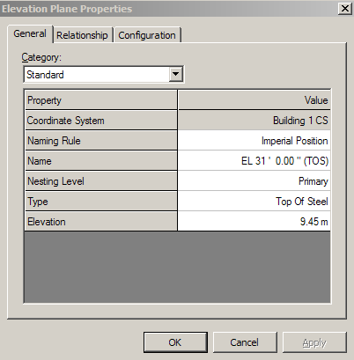
Grid Entities Manipulation
Place/Edit Elevation Plane ribbon bar
and Properties Page
Position step
CS
Type
Reference
Offset
Copies
Nesting level

Slide 20
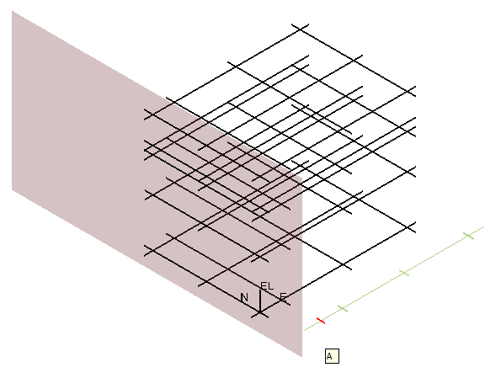
Grid Entities Manipulation
Place/Edit Grid Plane Command
Control-Shift select Grids Planes
from Rulers (like WSE)
Dynamic display of new Grid
Plane location on ruler
Dynamic
Display
Multi-Select Grid Planes

Slide 21
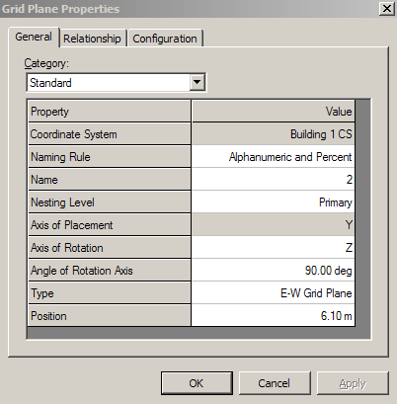
Grid Entities Manipulation
Place/Edit Grid Plane ribbon bar
and Properties Page
Position step
CS
Axis
Type
Reference
Offset
Copies
Nesting level

Slide 22
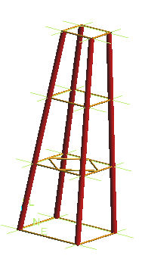
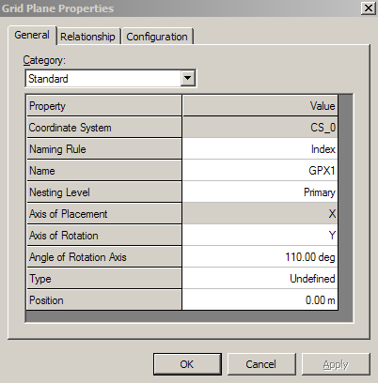
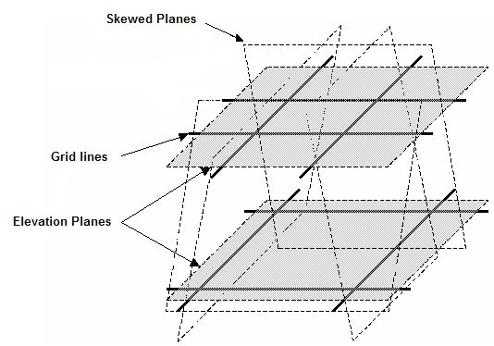
Grid Entities Manipulation
Skewed Grid Plane
Towers
Offshore Jackets

Slide 23
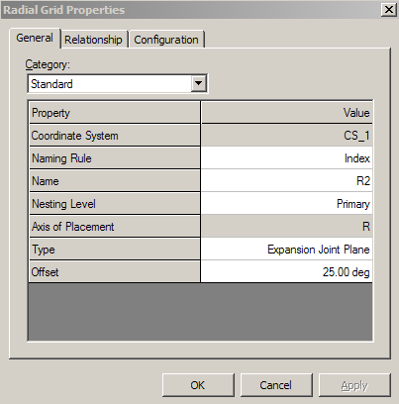
Grid Entities Manipulation
Place/Edit Radial Plane ribbon bar
and Properties Page
Position step
CS
Axis
Type
Reference
Offset
Copies
Nesting level

Slide 24
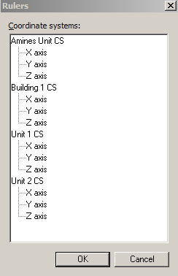
Rulers
Rulers control the display of reference planes loaded in a workspace. When you place objects in the model, you can use rulers to help you locate the exact point along a plane
Displays all the coordinate systems defined for the model
Use the Ctrl key and select coordinate system node will automatically selects all axis to turn on/off the rulers

Slide 25
Lab – 2 (3 and 4)

